Slide 1
HOS303A: International Restaurant Concepts
Topic 5

Slide 2
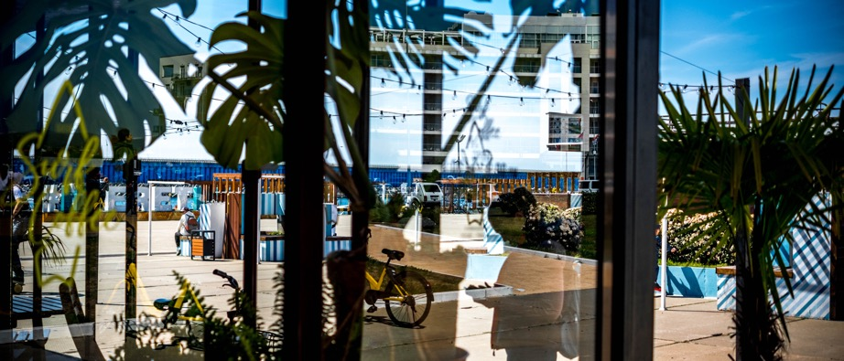

International Restaurant Concepts
Excursion

Slide 3

Weekly Content
This week, you will be observing several versions of the same concept in a neighbourhood.
This will build on the content you’ve covered so far and prepare you for your assessments.

Slide 4
Concept and Market
Quality
Menu
Price
Atmosphere
Location
Management
Food
Service
(Walker, 2014, page 67)

Slide 5

What is a Competitor?
For restaurants, a competitor is any business that sells food to the same target market.
Direct or Indirect competition?
(RestoHub, n.d)

Slide 6
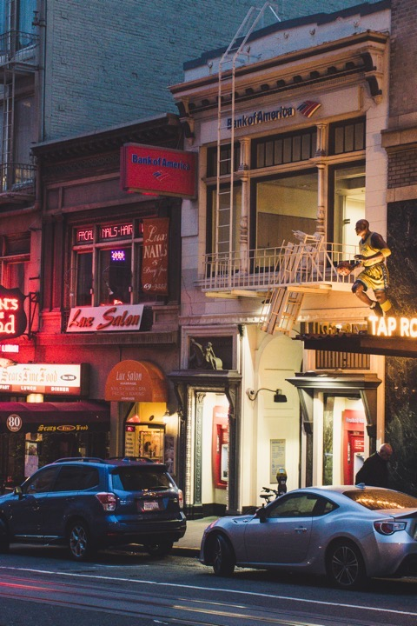
Direct or Indirect Competition?
Direct competitors
  They sell the same restaurant cuisine, operate under the same service model and appeal to the same target market.
Indirect competitors can sell different types of cuisine or operate under a different service model.
  These businesses are competition because they cater to the same target market.
  Indirect competitors might not offer the exact same meals, they are still vying for the same guests.
(RestoHub, n.d)

Slide 7
Examples
Direct Competition
Indirect Competition

Slide 8
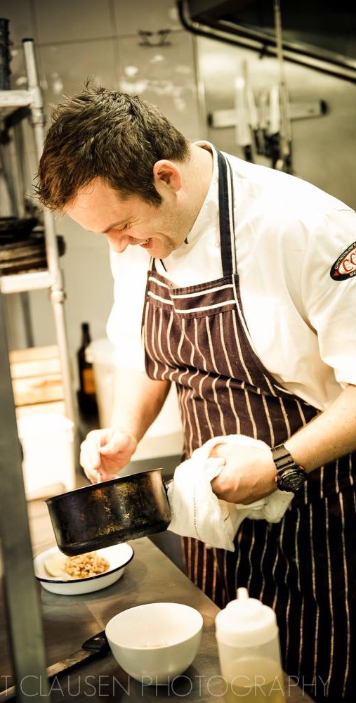
5.3 Pearls of Wisdom
“The importance of analysing your competition” with Bryn Evans
Bryn began his career at the Michelin starred Chester Grosvenor, with further placements at several other Michelin starred restaurants. He has a reputation as an award wining Head Chef before going on to open his own business in Wales.
In this video, Bryn talks through the importance of analysing your competition as part of your Business Plan

Slide 9


Why Create a Competitor Analysis?
Evaluating competitors can also help determine the market’s appetite for a concept.
If competition is doing well, the odds for success are higher.
If not, it might mean there’s an unnecessary risk and the concept or location needs to be re-evaluated.

Slide 10

5.1 Video: SWOT Analysis on Restaurant Business
Watch here [3.44mims] https://www.youtube.com/watch?v=6QmP4oTFeac&feature=youtu.be

Slide 11

5.4 Activity
As part of this week's excursion, complete the worksheet in accordance with the content requested to the best of your ability. You will need to undertake some online research and observations in person.
This activity will help prepare you for your first and second assessments and you will make use of techniques required for your other assessments.

Slide 12


5.5 Activity
After you've completed Activity 5.4, create a summary noting which concept you chose to research (cafe, Thai restaurant, burger bars etc.)
Which of the venues you thought was the most successful explaining your reasons including comment on direct and indirect competition.
Ensure to add the activity worksheet (5.4) as an attachment and include images to support your content. We will discuss these at the start of our next class.

Slide 13
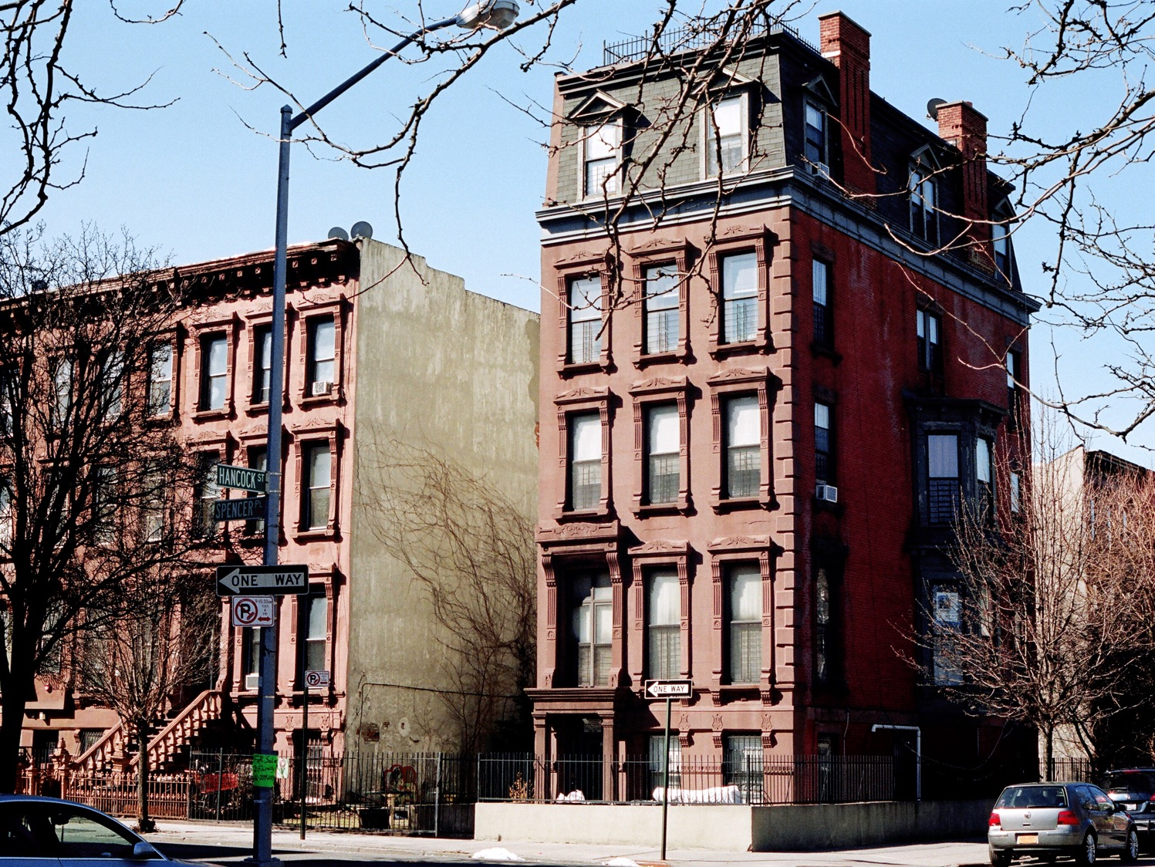
Activity 5.6
Getting to know Brooklyn in New York….
This is your opportunity to start researching the characteristics of the Brooklyn area in preparation for your second assessment...
https://icms.padlet.org/nassima_kennedy1/7zx10bxemsm3ychq
Password: HOS303A

Slide 14

Questions…

Slide 15
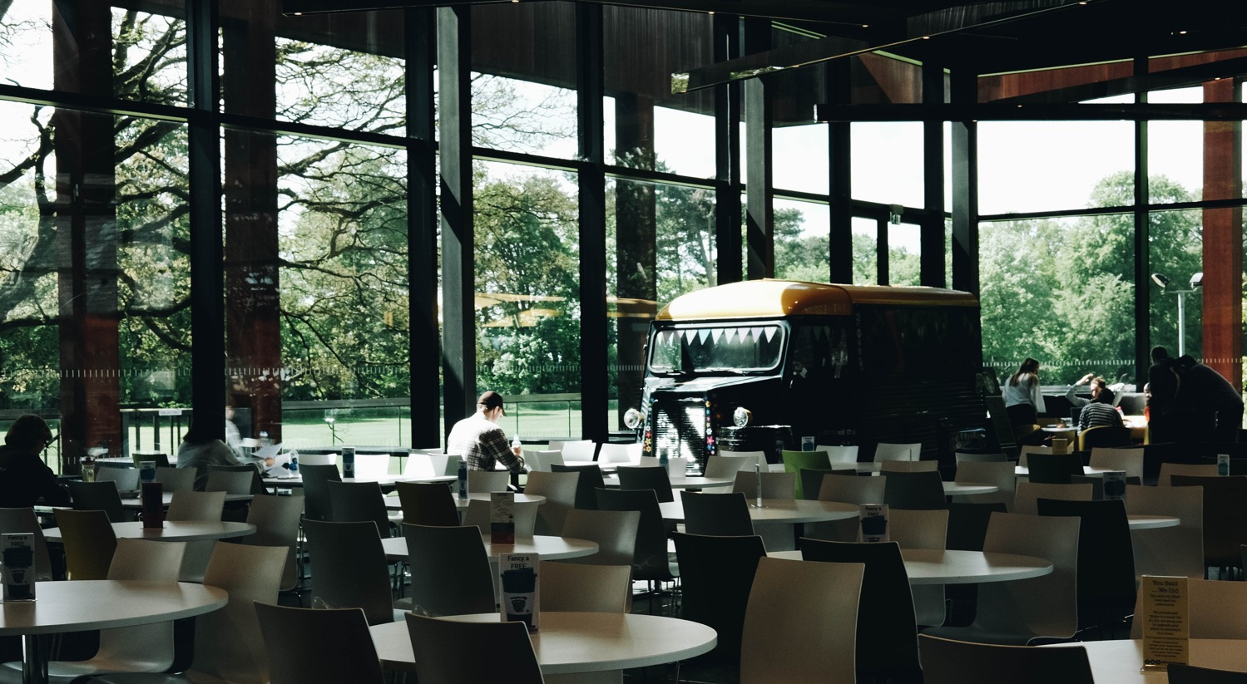
Next Week…Restaurant Design
Please complete Activity 6.1 before class https://icms.padlet.org/nassima_kennedy1/22ghbe9yj7wox8er
Password: HOS303A
Think of a restaurant décor you particularly enjoyed and explain what you liked about it.

Slide 16


Sources
Restaurant Competitive Analysis (n.d). RestoHub. Retrieved from https://www.restohub.org/operations/planning/restaurant-competitive-analysis/
Walker, J. R. (2017). The restaurant : from concept to operation. [Book] (8th ed.). John Wiley
Walker, J. R. (2014). The restaurant : from concept to operation. [Book] (7th ed.). John Wiley

Slide 17
Thank you
What questions do you have?...
COMMONWEALTH OF AUSTRALIA
Copyright Regulations 1969
WARNING
This material has been reproduced and communicated to you by or on behalf of International College of Management, Sydney pursuant to Part VB of the Copyright Act 1968 (the Act).
The material in this communication may be subject to copyright under the Act. Any further reproduction or communication of this material by you may be the subject of copyright protection under the Act.
Do not remove this notice.

